Slide 1
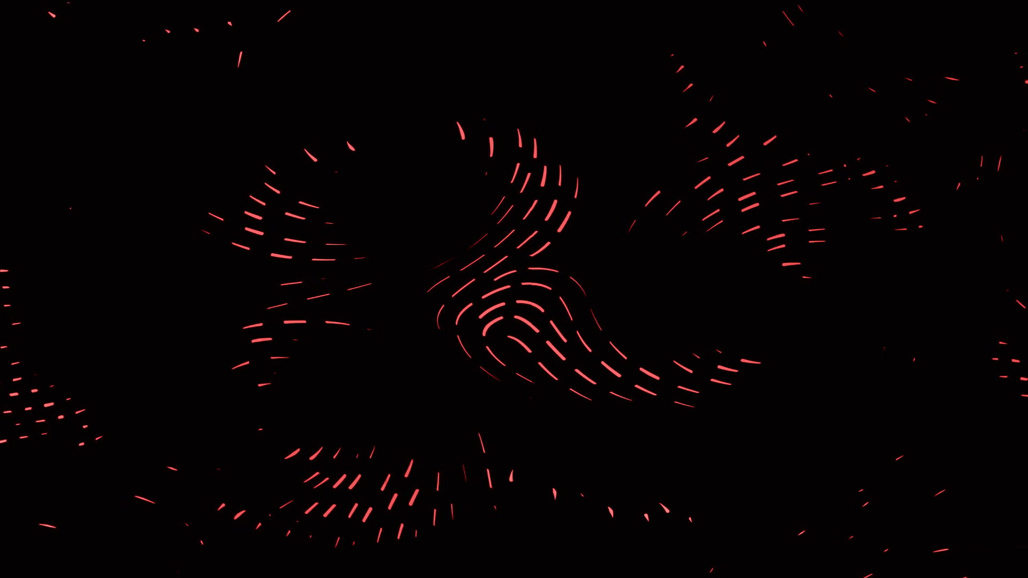

DYNAMIC MAZE SOLVER
Presented By:
K. Sripriya- 22R11A0523

Slide 2
ABSTRACT
The Dynamic Maze Solver is a Java-based application designed to provide an interactive and visual approach to solving mazes using the Swing framework. Users can dynamically set the start and end points within a grid-based maze by clicking on the desired cells, with left-clicks designating the start and right-clicks setting the end. The maze incorporates static walls as obstacles, enhancing the complexity of pathfinding tasks. The graphical interface features color-coded cells to represent different states: black for walls, white for open paths, orange for the start point, blue for the end point, cyan for visited cells, and pink for the final shortest path. The visualization adapts to window size, ensuring a consistent display. The application utilizes the Breadth-First Search (BFS) algorithm to determine the shortest path from the start to the end point. BFS is chosen for its efficiency in finding the shortest path in unweighted grids by exploring nodes level by level and employing a parent map to reconstruct the path from end to start. Users can initiate the pathfinding process by pressing the Enter key, and the system provides immediate feedback if either the start or end points are unset or if no path exists, enhancing user interaction and engagement. The rendering of the maze is handled by a custom JPanel subclass, MazePanel, which ensures that the grid is dynamically resized and updated to reflect the user's interactions and the pathfinding results. The Dynamic Maze Solver is a practical educational tool that demonstrates key concepts of graph traversal and algorithmic problem-solving, making it particularly valuable for teaching and learning environments. It combines an intuitive user interface with a robust algorithmic foundation, providing a hands-on approach to understanding the dynamics of maze-solving techniques.

Slide 3

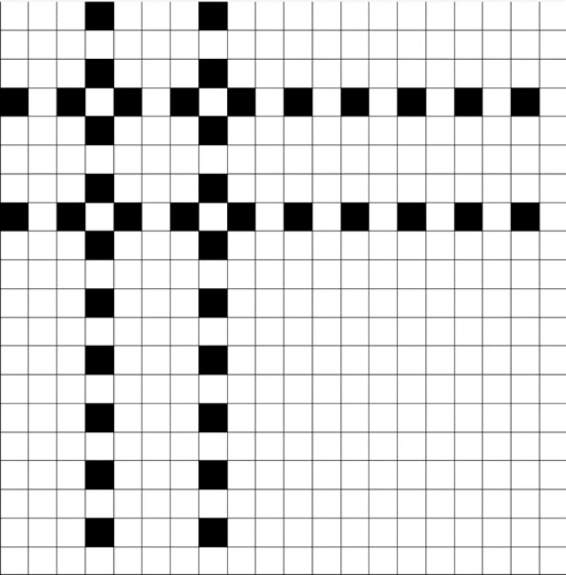
OUTPUT

Slide 4
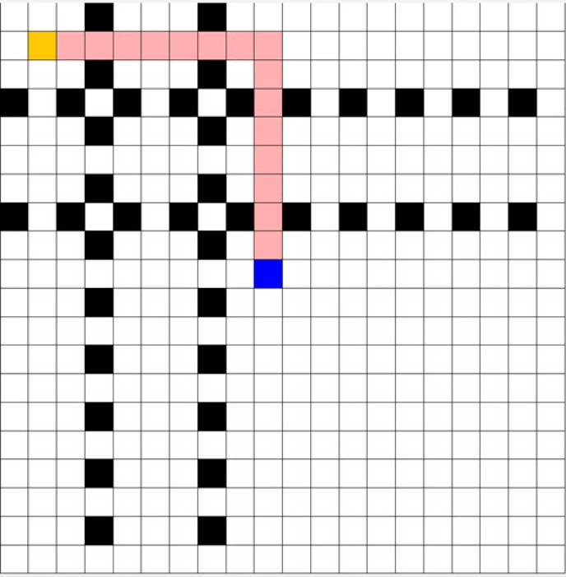
OUTPUT

Slide 5
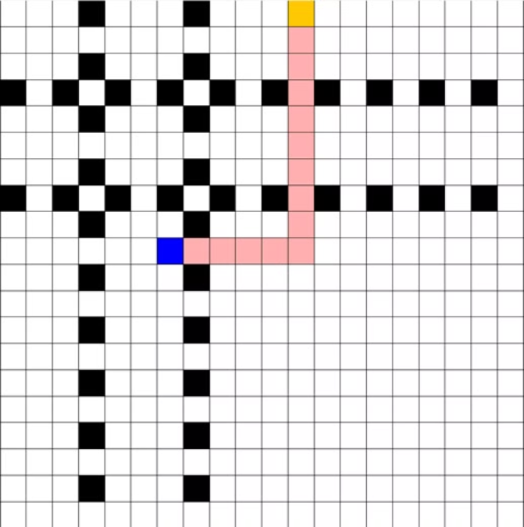
OUTPUT

Slide 6

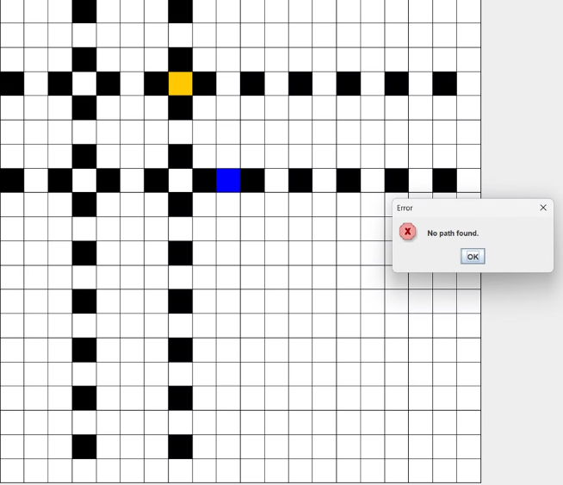
OUTPUT

Slide 7

CONCLUSION
The Dynamic Maze Solver effectively combines intuitive graphical interface design with algorithmic problem-solving to create a comprehensive educational tool. Through interactive features, users can dynamically set start and end points within a maze and immediately visualize the process of finding the shortest path using the Breadth-First Search algorithm. The application underscores the practical utility of BFS for unweighted grid traversal, ensuring an optimal path discovery in a clear and understandable manner. By visually representing various states of the maze—such as walls, open paths, visited cells, and the final path—it provides a detailed insight into the mechanics of pathfinding algorithms.
This project serves not only as an engaging demonstration of fundamental algorithmic principles but also as a powerful learning aid. It highlights the significance of visual tools in enhancing comprehension of complex concepts, thereby making them more accessible to learners. Moreover, the dynamic and interactive nature of the tool emphasizes the importance of user experience in educational software, allowing for a more hands-on approach to learning.
In conclusion, the Dynamic Maze Solver bridges the gap between theoretical algorithmic knowledge and practical application, offering a compelling way to explore and understand maze-solving techniques. Its integration of real-time interaction and visual feedback makes it a valuable resource for both teaching and self-learning, illustrating the potential of interactive educational tools in fostering a deeper understanding of algorithmic problem-solving.

Slide 8

THANK YOU

